Slide 1

Face recognition
Ammar Yasser Helmey Alnagar 201801360
Ibrahim Mamdouh Ibrahim 201801174
Sheriff Magdy Barakat 201801308
Hend Hany Mohamed Ahmed 201801890
Mohamed Ahmed Mohamed amin 201801391
Alaa Harby Ahmed Shawer 201801235

Slide 2
Table of contents :-
Abstract
The Process of Automatic Face Recognition consists of
Figure of the process
Face detection
Face alignment
Feature extraction
Face recognition tasks
Applications of face recognition
Advantages and disadvantages
Controversies

Slide 3
Abstract:-
Face recognition technology is a biometric technology, which is based on the identification of facial features of a person.
People collect the face images, and the recognition equipment automatically processes the images.
Face recognition has become the future development direction and has many potential application prospects.

Slide 4
The Process of Automatic Face Recognition consists of :-
Face Detection.
1
Face Alignment.
2
Feature Extraction.
3
Face Recognition.
4

Slide 5
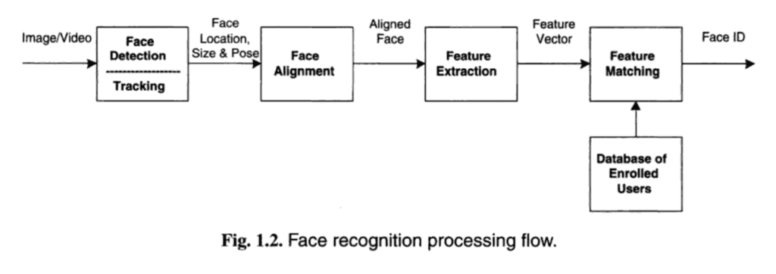
A figure representing the process flow :-

Slide 6
Face detection
Definition
Applications
Difference between face detection and face recognition
Face detection task

Slide 7
Face Alignment
Definition.
Usage
Methods

Slide 8
Feature Extraction
Definition
Most knownTechniques

Slide 9
Face Recognition Tasks
Face Matching: Find the best match for a given face.
Face Similarity: Find faces that are most similar to a given face.
Face Transformation: Generate new faces that are similar to a given face.

Slide 10
Applications of face recognition
Social media
ID verification
Face ID

Slide 11
Advantages and disadvantages
Compared to other biometric systems
Weaknesses
Ineffectiveness

Slide 12
Controversies
Privacy violations
Imperfect technology in law enforcement
Data protection

